Slide 1
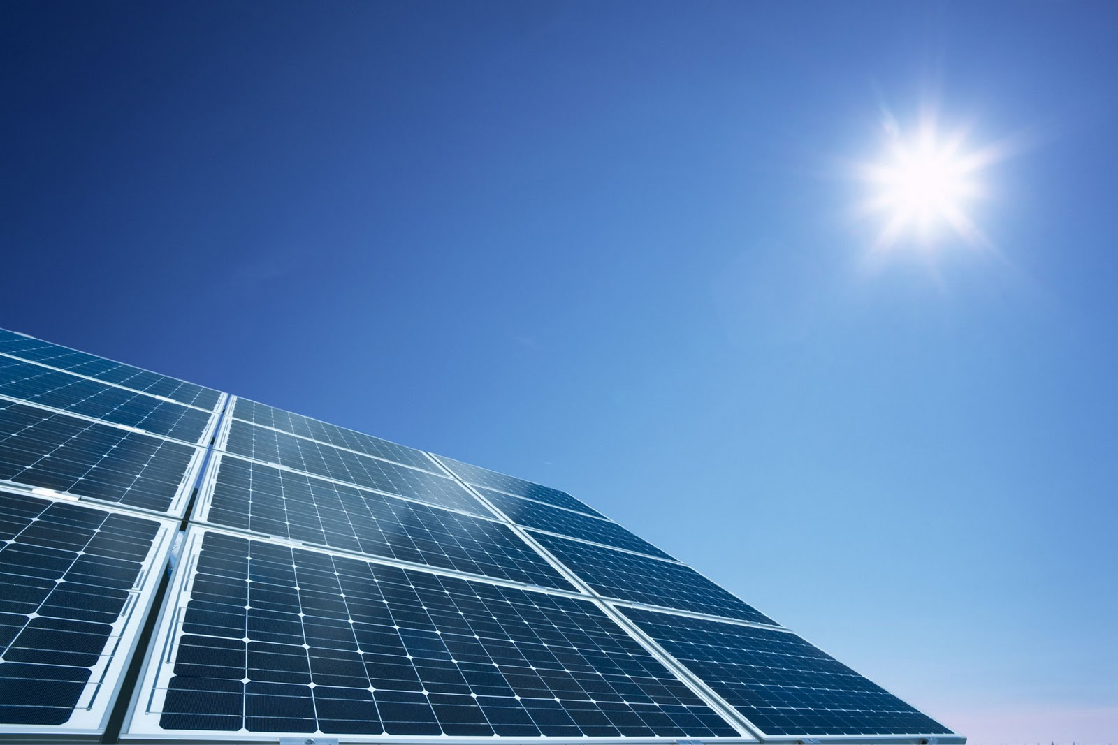
Solar Energy Timeline
Solar Energy is energy emitted by the sun.
It reached earth 4.5 billion years ago and hasn’t stopped since!

Slide 2
3rd Century
BC
Solar Energy was used by Greeks and Romans to make fire, for religious purposes and to attack warships using their bronze shields.
1st to 4th Century A.D
Roman bathhouses had large south facing windows to let in the suns warmth.
1200’s
Anasazi people of North America lived in south-facing cliff dwellings.

Slide 3
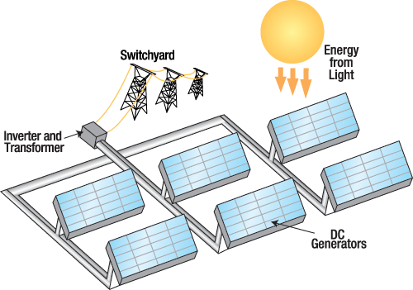
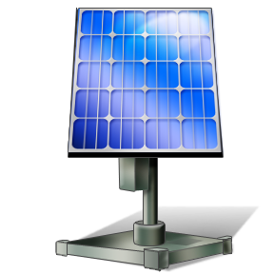
1839
Becquerel discovers photovoltaic effect which is the changing of solar energy to chemical energy.
1860’s
Mouchet proposed the idea of solar powered steam engines. In the following 20 years he and his assistant constructed the first one of its kind.
1887
James Moser reports dye sensitized photoelectrochemical cell.

Slide 4
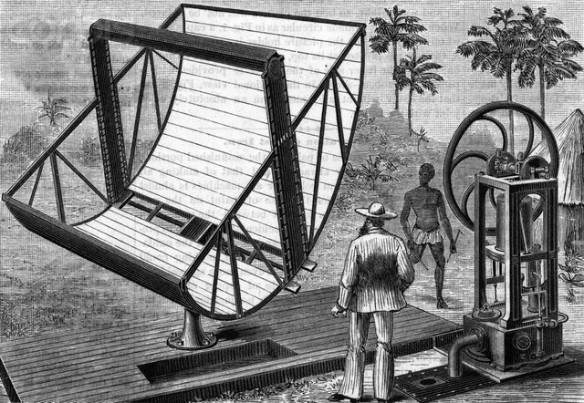
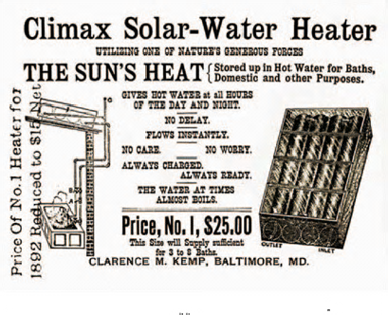
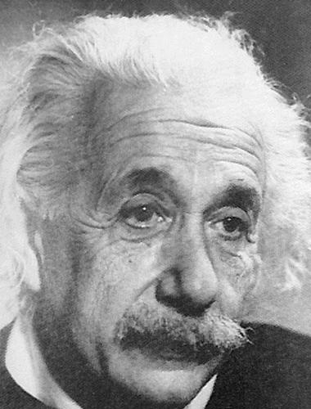
1880’s
American engineer John Ericsson develops solar-driven motors.
1891
Clarence Kemp invents first commercial solar heater
1905
Albert Einstein publishes his paper on the photoelectric effect. He later wins a Nobel Prize for his theories

Slide 5
Did You Know…
…that in 1990 the first Aircraft EVER flew over the US only using Solar Energy.

Slide 6
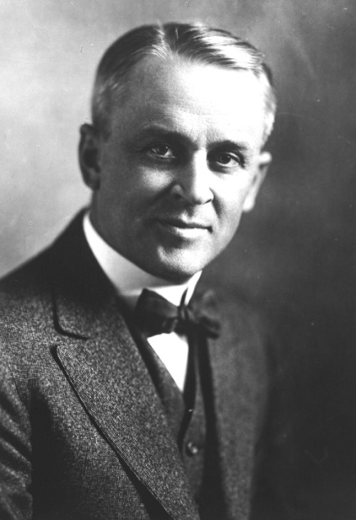
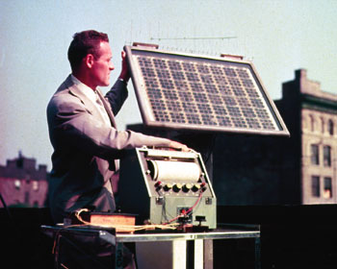
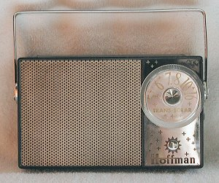
1908-1916
William Bailley invents a solar collector with copper coils and an insulated box, roughly, it’s present design. Robert Millikan provided experimental proof of the photoelectric effect.
1950’s
1959-60
Hoffman Electronics introduce a 10% efficient solar cell and a 14% efficient solar cell. They also introduce the use of a grid contact that reduces the cell’s resistance.
Bell labs produce solar cells for space activities. First modern silicon cell invented by Bell Labs which had 6% efficiency.

Slide 7
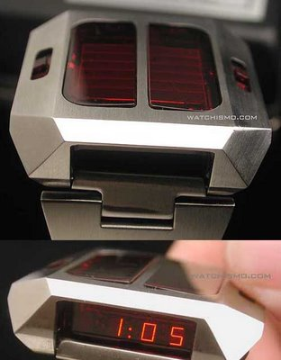
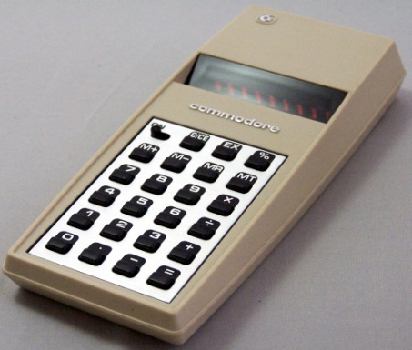
1961
‘Solar Energy in the Developing World’ conference is held by the United Nations.
1963-1968
Sharp Corporation produce a module of silicon cells (solar panel). Roger Riehl introduces first solar powered wrist watch.
Late 1970’s
First solar powered calculators are invented. Solar Energy becomes increasingly popular.

Slide 8
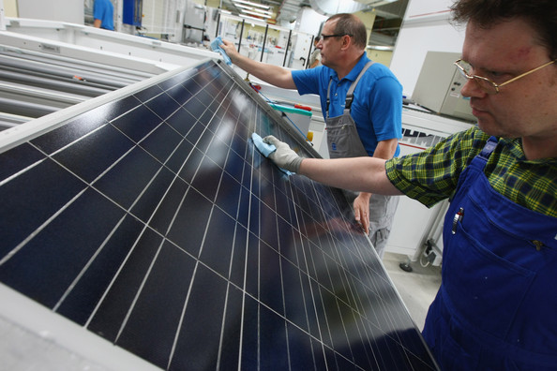
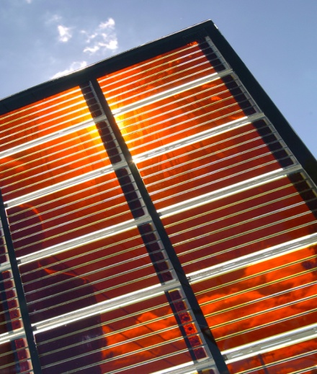
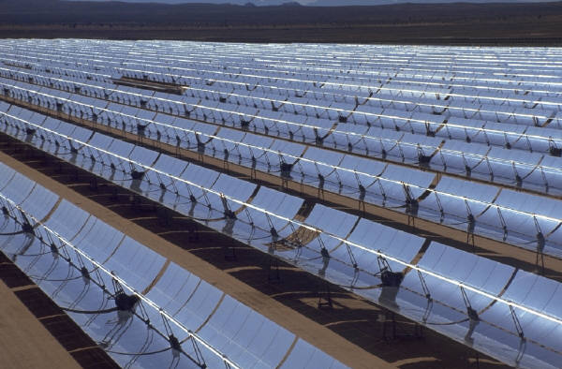
1983
Worldwide Photovoltaic production exceeds 21.3 megawatts and sales exceed $250 million.
1991
Efficient Photoelectrochemical cells are developed as well as the Dye-Sensitized solar cell (Grätzel cell).
The world invests money into research of solar energy and other renewable energies. The total worldwide installed photovoltaic power reaches 1000 megawatts.
1980-1999

Slide 9
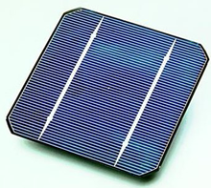
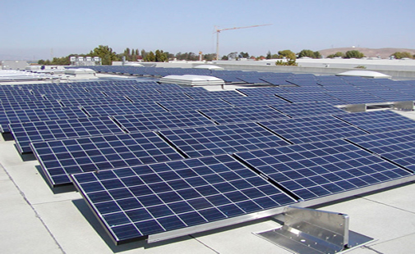
2006-Future
New Solar Cells continue to break the 40% efficiency mark and will continue to do so in the future.
2011
Fast growing factories in China flood the market with silicon photovoltaic modules pushing the cost down to $1.25 per watt. Installations double worldwide.
3D PV-cell-30% efficiency. The price of Chinese solar panels (crystalline module) fell to $0.60/Watt.
2012

Slide 10

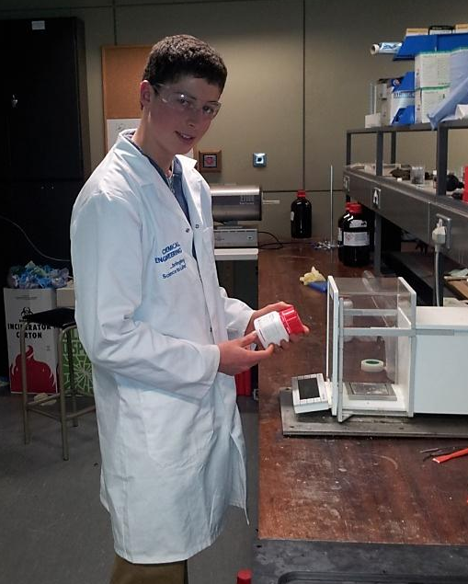
This project was made by Jack Gallagher during his Work Experience week at the Solar Energy Cluster Programme
4th-8th March 2013

Slide 11
References
Content
http://www1.eere.energy.gov/solar/pdfs/solar_timeline.pdf
http://www.en.wikipedia.org/wiki/Timeline_of_solar_cells
Solar Energy History. Lesson 1: Solar Energy Introduction- Azrise (Photovoltaic Solar Energy High School Science Curriculum)
Photos
John Ericsson’s Motor Image- http://www.corbisimages.com/images/Corbis-BE052560.jpg?size=67&uid=f4aee60a-17c5-4340-b6fe-d90fc0ca0959
‘Einstein’ Image-http://www.omikk.bme.hu/archivum/angol/kepek/002.jpg
Solar Water Heater- http://atonenergy.com/wpimages/wp1188b228_06.png
PV effect- http://www.photovoltaic-solar-power.net/wp-content/uploads/2011/10/Photovoltaic-Solar-Power-1.gif
Milikan- http://www.quotecollection.com/author-images/robert-millikan-3.JPG
Hoffman- http://www.transistor.org/collection/hoffman/hoffmanKP706.jpg
Solar powered wristwatch- http://3.bp.blogspot.com/_FzrCmNCKIdg/SCV_PTmyGEI/AAAAAAAABDY/k3ZG5Wglmsw/s400/solarsynchronar.jpg
Dye sensitized solar panel- http://www.asknature.org/images/uploads/product/b57e64dd3a2a1a9d36a92a5a51ef7293/dsc_0097.jpg
Solar Panel Production- http://www1.pictures.zimbio.com/gi/Conergy+Expands+Solar+Panels+Production+_d1cCWK6rArl.jpg
All remaining photos came from Clip Art
Solar panel (crystalline)- http://windsunenergysystems.com/wp-content/uploads/2011/05/Sun-Link-Rack-Mounted-Crystalline-Solar-Panels-on-Roof.jpg
Solar cell-http://upload.wikimedia.org/wikipedia/commons/thumb/9/90/Solar_cell.png/220px-Solar_cell.png
Solar panel slide 1- http://2.bp.blogspot.com/-EYE4W3Li37Q/TyceKfjyesI/AAAAAAAAAc4/ukHW4olEUpM/s1600/Solar+Power.jpg

